Slide 1
Deep Neural Networks
(AIML CZG511)
Dr. YVK Ravi Kumar
(yvk.ravikumar@pilani.bits-pilani.ac.in)

Slide 2

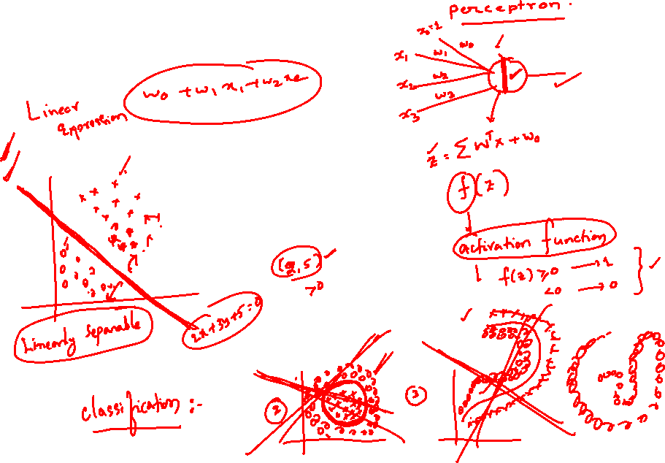
Session 3
(10th May,2026)

Slide 3
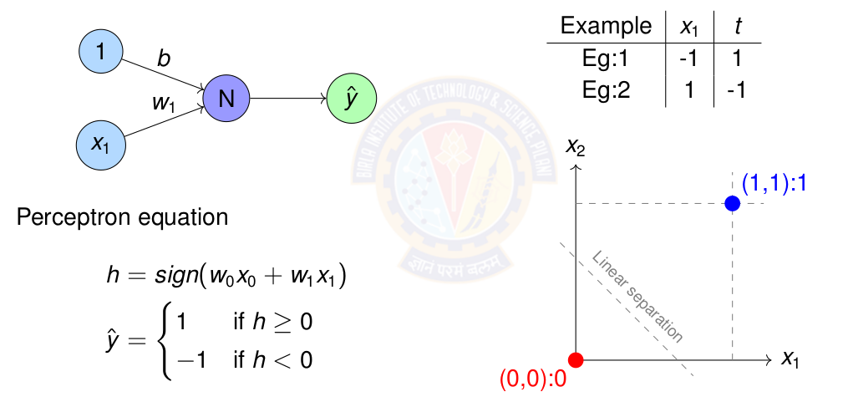
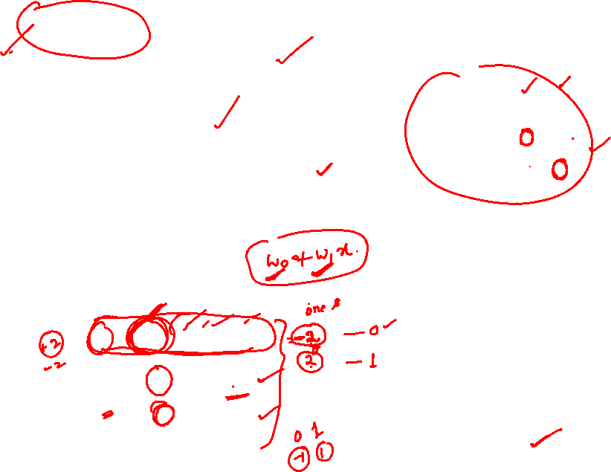
Perceptron Learning for NOT gate

Slide 4
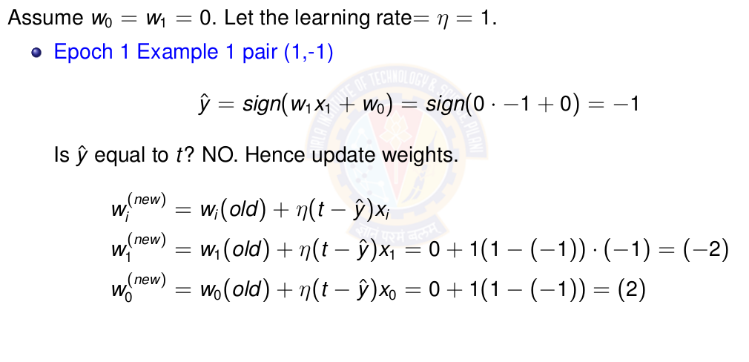
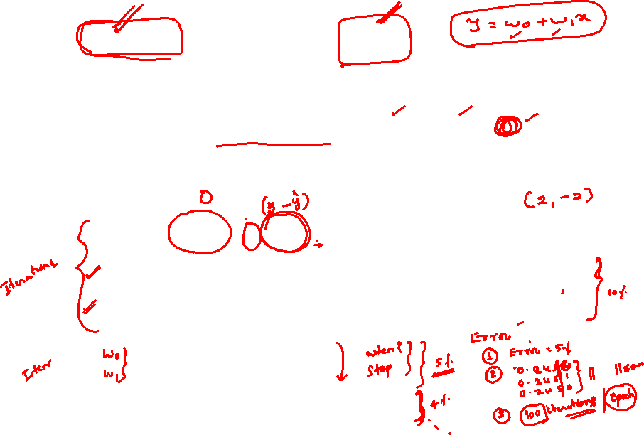
Perceptron Learning for NOT gate

Slide 5
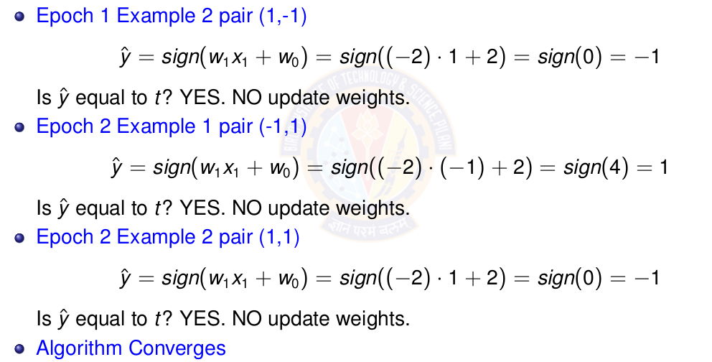
Perceptron Learning for NOT gate

Slide 6
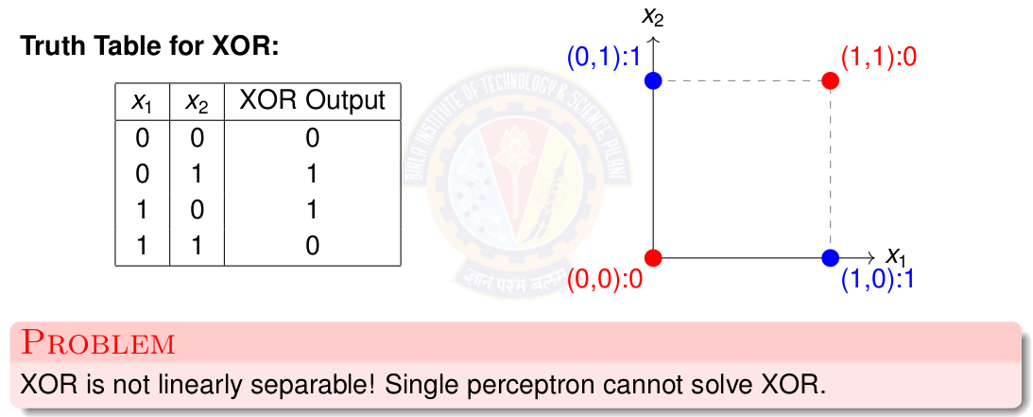

The XOR Problem

Slide 7
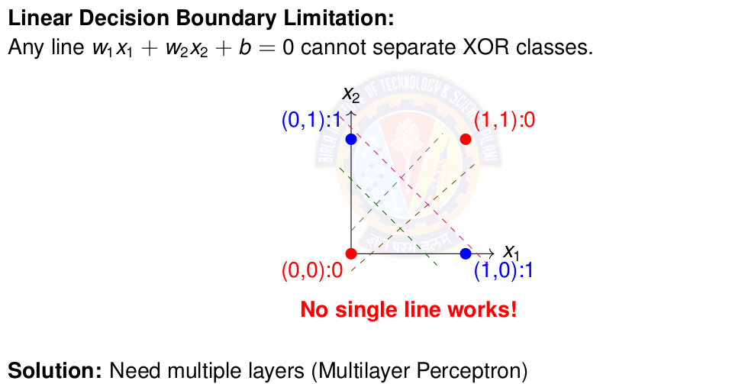
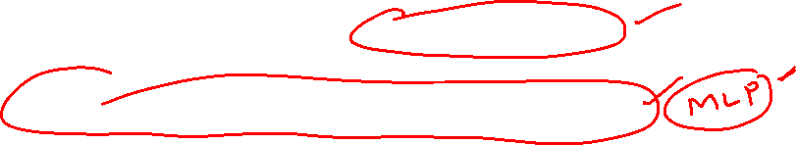
Why Single Perceptron Fails on XOR

Slide 8
Linearly Separable Data
Two sets data points are separable in a n-dimensional space if they can be separated by an (n-1) dimensional hyperplane.
A straight line can be drawn to separate all the data examples belonging to class +1 from all the examples belonging to the class -1. Then the two-dimensional data are clearly linearly separable.
An infinite number of straight lines can be drawn to separate the class +1 from the class -1.

Slide 9
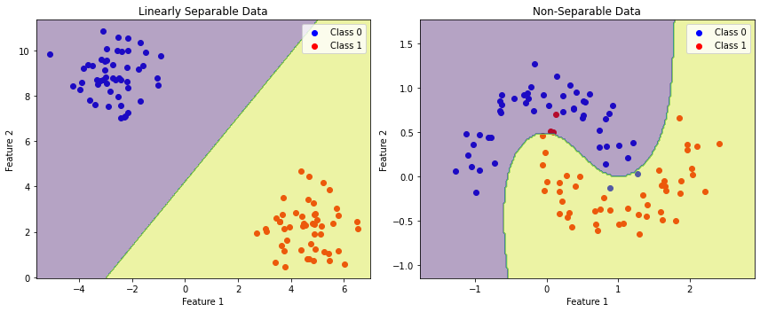
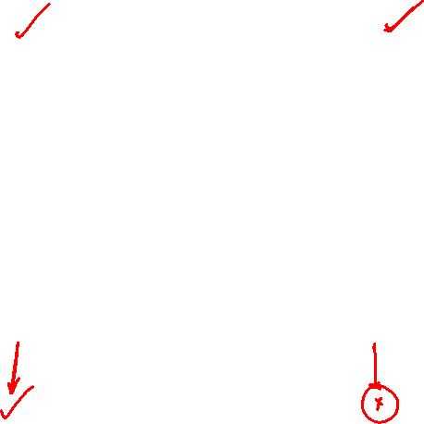
Linearly vs Non-Linearly Separable Data

Slide 10
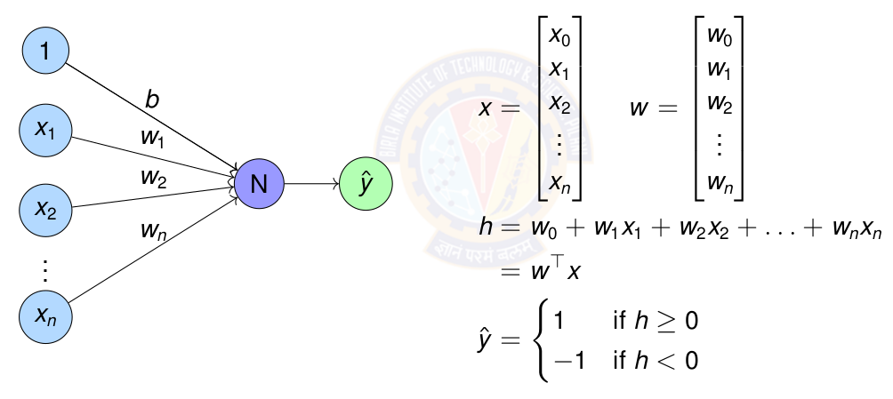
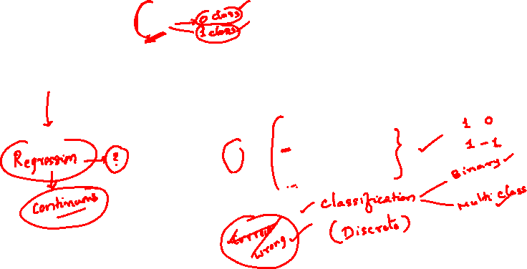
Perceptron for Linearly Separable Data

Slide 11
Table of Contents
Regression
Linear Regression
The Linear Model: Single Neuron
Worked Example
Evaluation
Python Implementation Implementation Tips
Summary

Slide 12
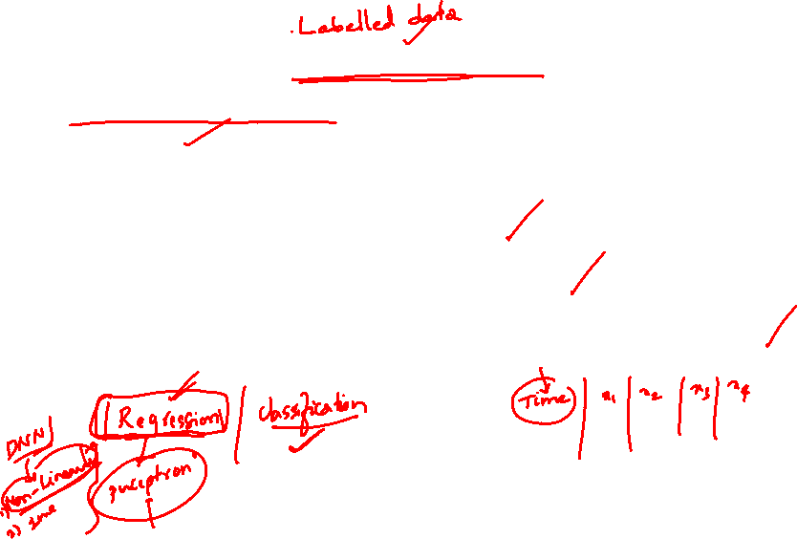
What is Regression?
Definition
Regression is a supervised learning task that predicts a continuous-valued output based on input features.
Key Characteristics:
Input: Feature vector x ∈ R^{d}
Output: Real-valued target y ∈ R
Goal: Learn a function f : R^{d} → R such that y ≈ f (x)

Slide 13
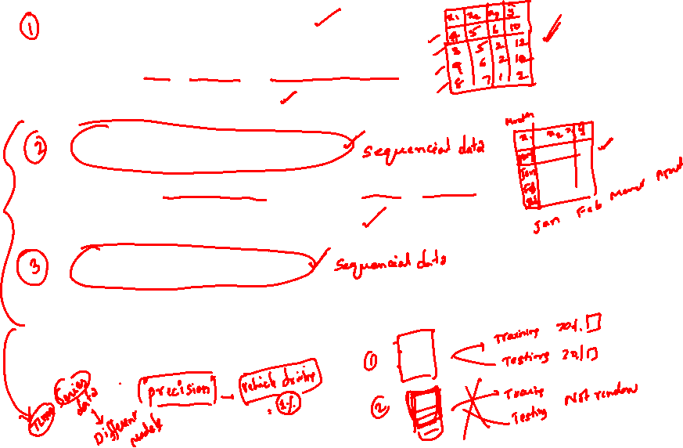
Examples of Regression Problems
House Price Prediction
Input: Size, location, number of rooms
Output: Price in dollars
Temperature Forecasting
Input: Historical weather data, season, humidity
Output: Temperature in degrees
Stock Price Prediction
Input: Historical prices, trading volume, market indicators
Output: Future stock price

Slide 14
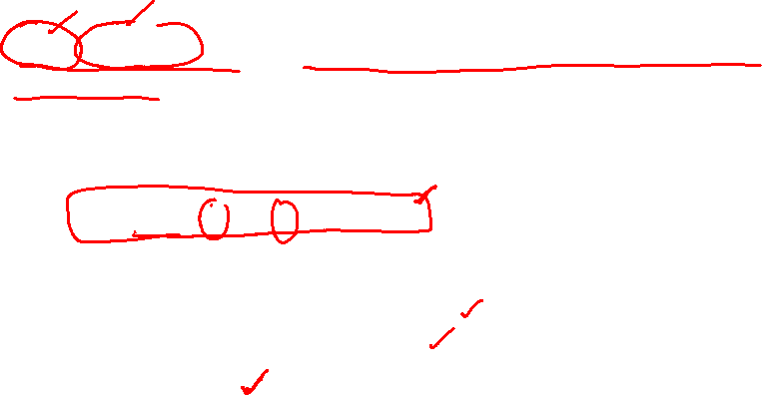
What is Linear Regression?
Definition
Linear regression assumes the output is a linear combination of the input features.
Mathematical Form:
y = w₀ + w₁x₁ + w₂x₂ + · · · + w_{d}x_{d}
where:
x = [x₁, x₂, . . . , x_{d} ]^{T} are the input features
w = [w₁, w₂, . . . , w_{d} ]^{T} are the weights
w₀ is the bias term

Slide 15

Examples of Linear Regression
Salary Prediction
Salary = w₀ + w₁ × Years of Experience
Crop Yield Prediction
Yield = w₀ + w₁ × Rainfall + w₂ × Fertilizer
Energy Consumption
Energy = w₀ + w₁ × Temperature + w₂ × Hour + w₃ × Day
The relationship between inputs and output is assumed to be linear.

Slide 16
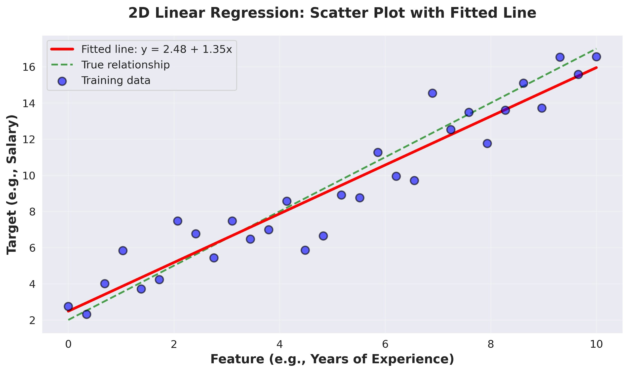
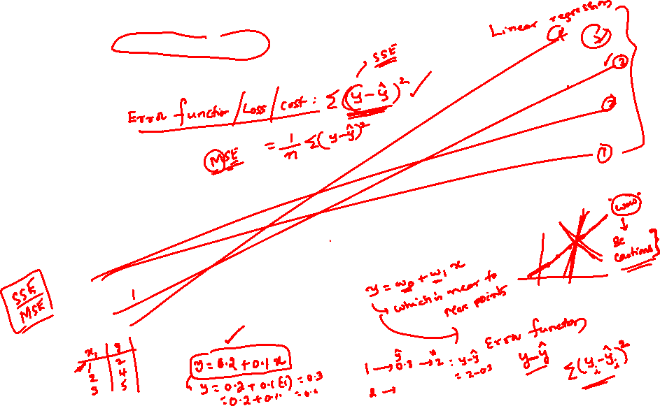
Visual Example: 2D Linear Regression

Slide 17
The Four Components
A complete machine learning system consists of:
Data: d -dimensional input vectors and target outputs
Model: Single neuron implementing linear function
Objective Function: Measures prediction error
Learning Algorithm: Gradient descent to optimize weights

Slide 18
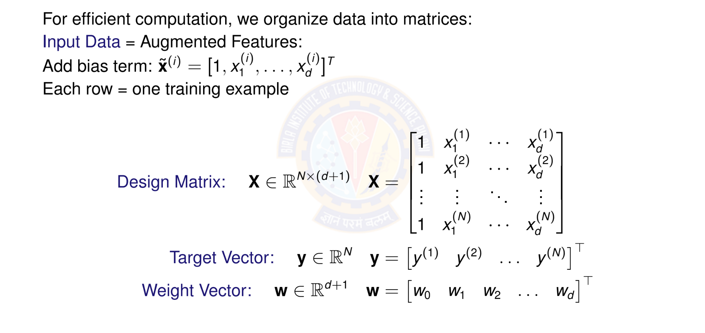
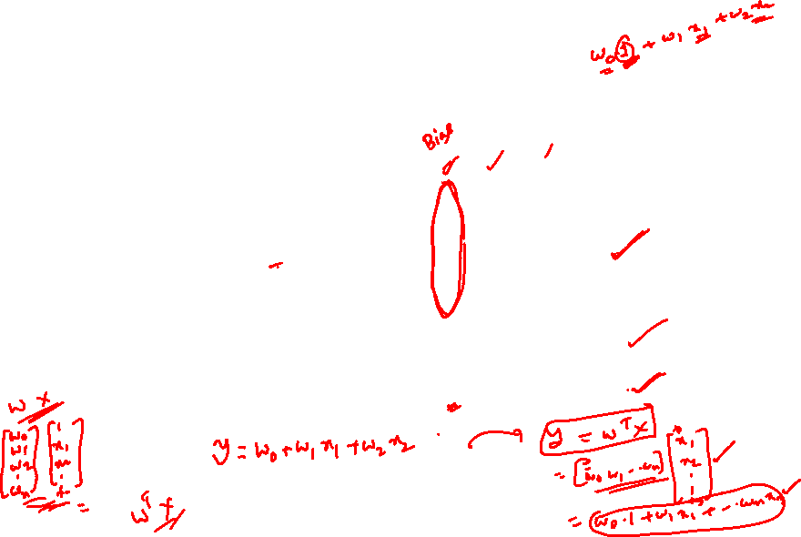
Matrix Form of Data

Slide 19

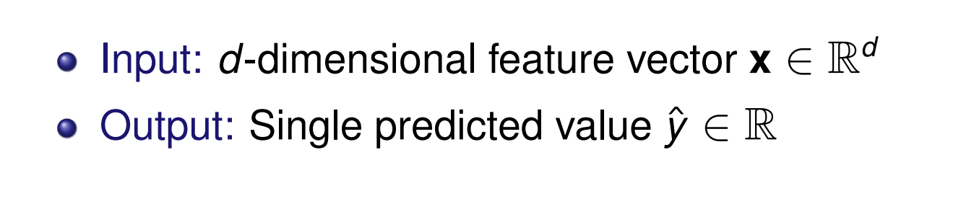
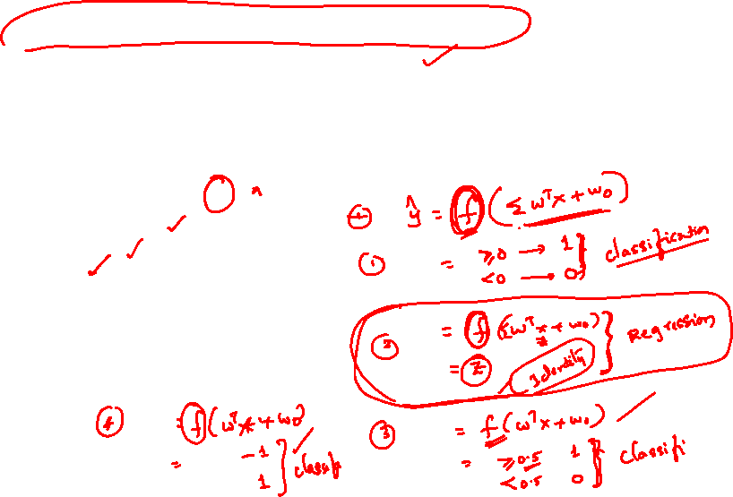
Linear Model as a Single Neuron
Model linear regression as a single artificial neuron:
1
x₁
w₀ w₁ w₂
Σ
f
y^{ˆ}
x
2
.
x_{d}
.
w_{d}

Slide 20

Linear Model Prediction
Linear Model Prediction
Model: A single neuron computes a weighted sum and applied identity activation function.
Prediction for input x:
y^{ˆ} = f (w^{T} x) = f (w₀ + w₁x₁ + w₂x₂ + · · · + w_{d} x_{d} )
(2)
where:
w = [w₀, w₁, . . . , w_{d} ]^{T} ∈ R^{d +1} are the model parameters
x = [1, x₁, . . . , x_{d} ]^{T} ∈ R^{d +1} is the input
f (·) is the identity activation f (z) = z
Vectorized form: for all predictions
y^{ˆ} = Xw
(3)

Slide 21
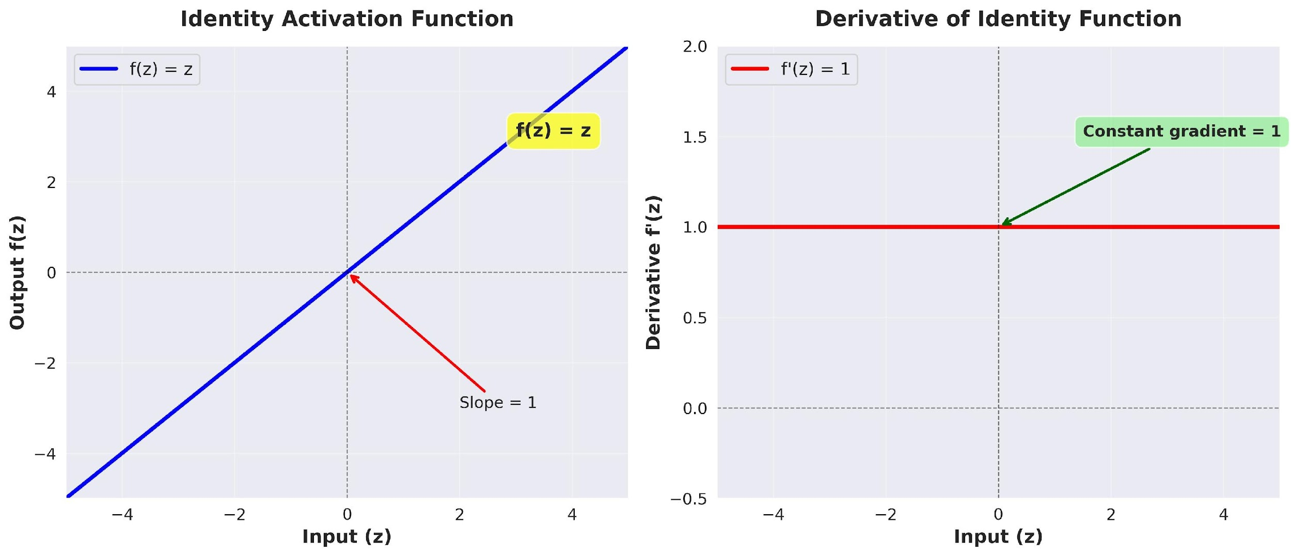
Identity Activation Function
Identity Activation Function
f (z) = z
(4)

Slide 22
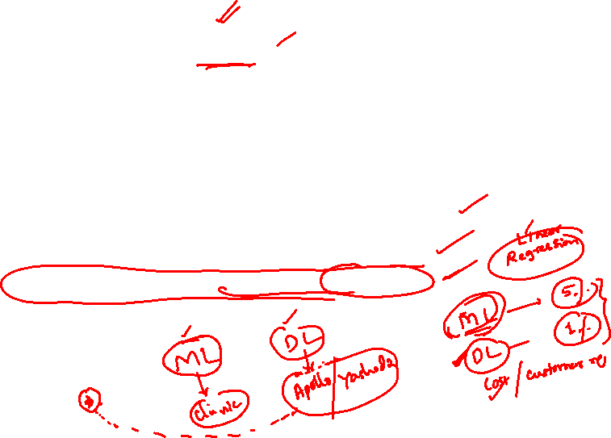
Identity Activation Function
Identity Activation Function
Properties of Identity Function
Output: Continuous, (−∞, ∞)
Differentiable everywhere: f '(z) = 1
Allows output to take any real value
Gradient flows unchanged through the neuron
Perfect for predicting continuous targets
Why identity for regression?
Target values are continuous (prices, temperatures, etc.)
Need to predict any real number, not just binary { 0,1 }
Differentiability enables gradient-based optimization
No information loss from input to output

Slide 23
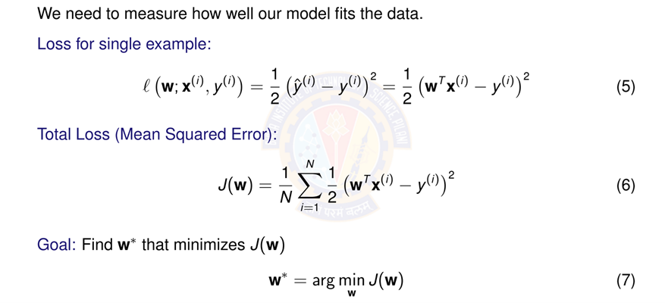
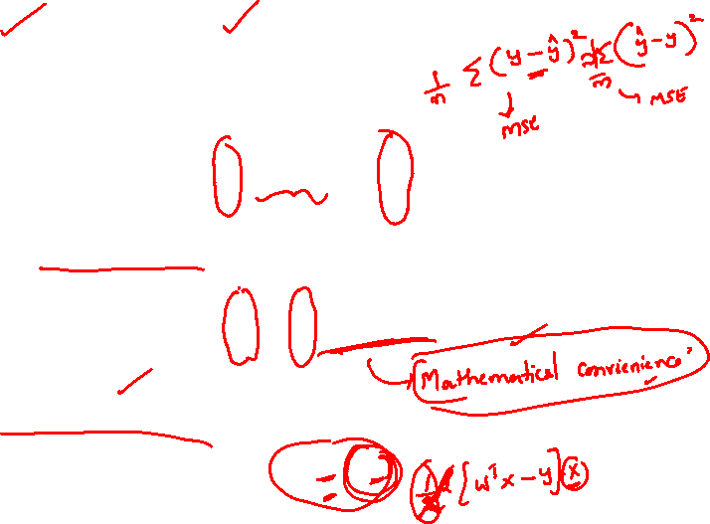
Objective Function: Squared Error Loss

Slide 24

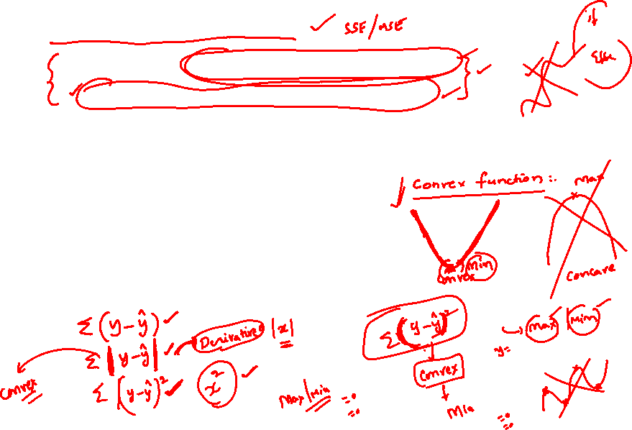
Why Squared Error?
Advantages of squared error loss:
Differentiable: Smooth everywhere, easy to optimize
Convex: Single global minimum (for linear models)
Penalizes large errors: Quadratic growth
Statistical interpretation: Maximum likelihood under Gaussian noise
Vector Form:
where X ∈ R^{N×(d +1)} is the design matrix and y ∈ R^{N} is the target vector.

Slide 25
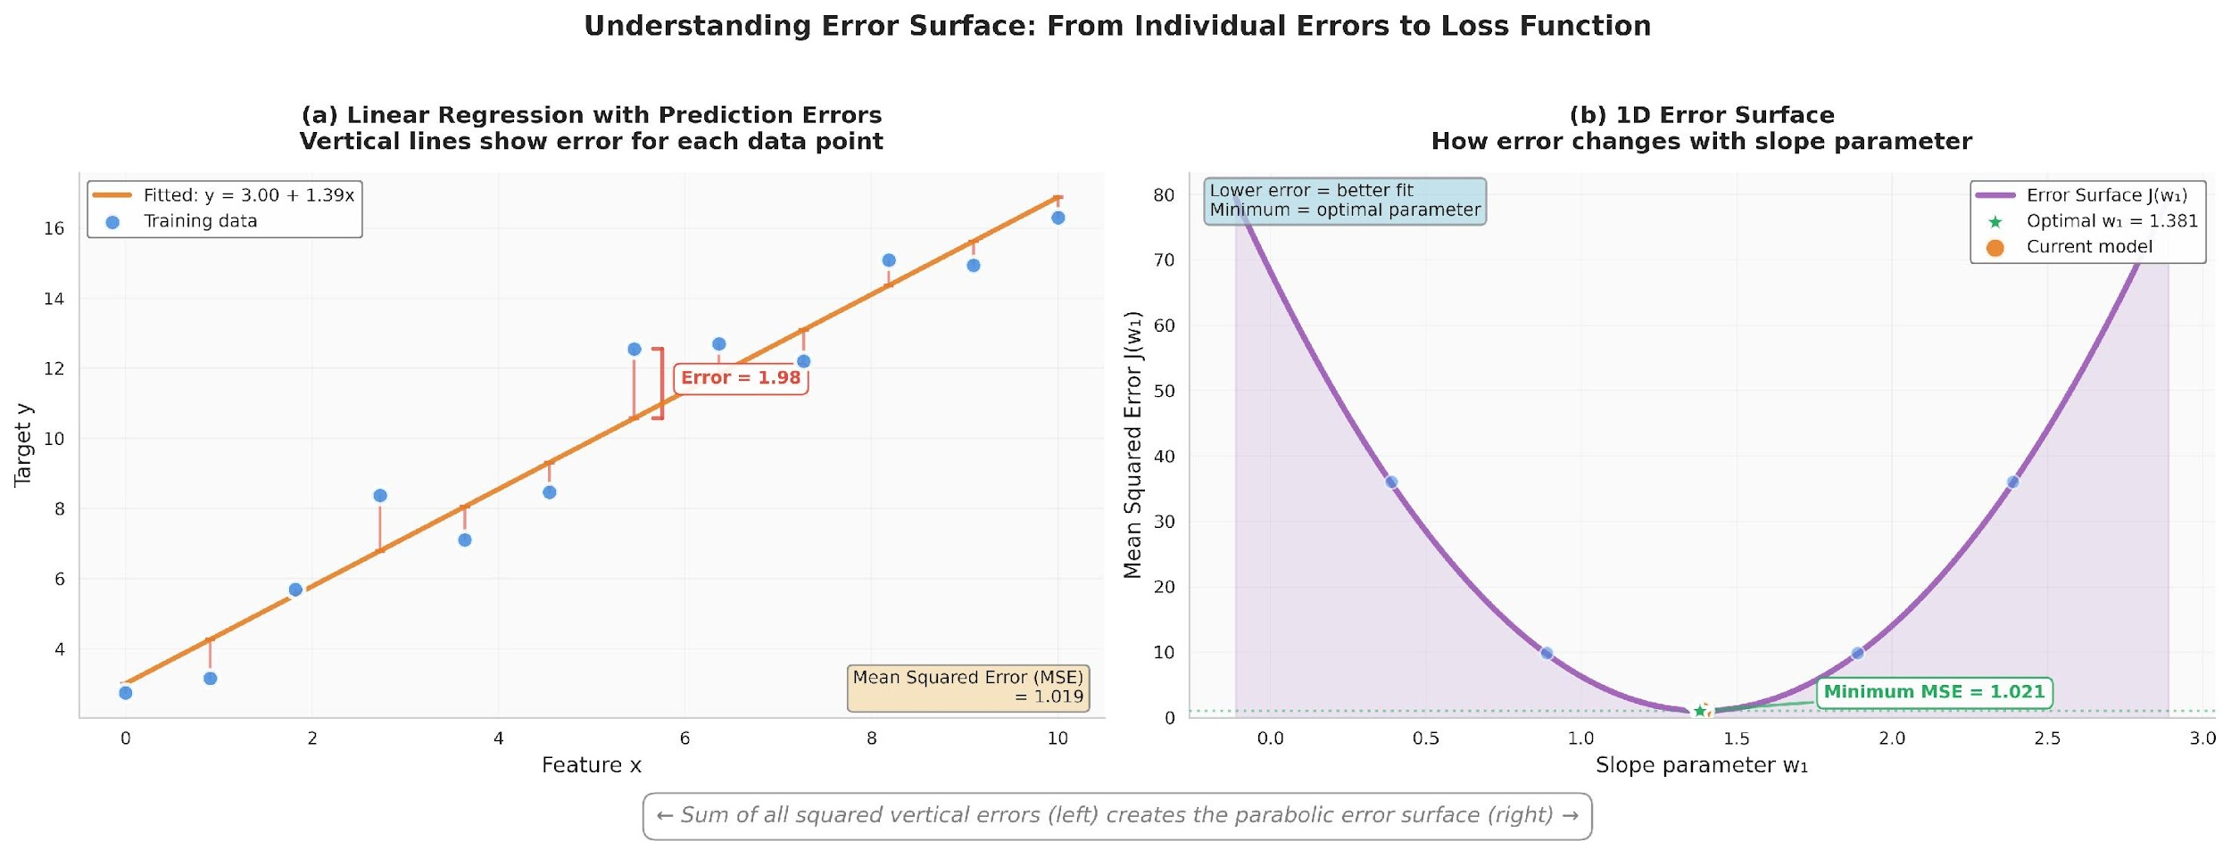
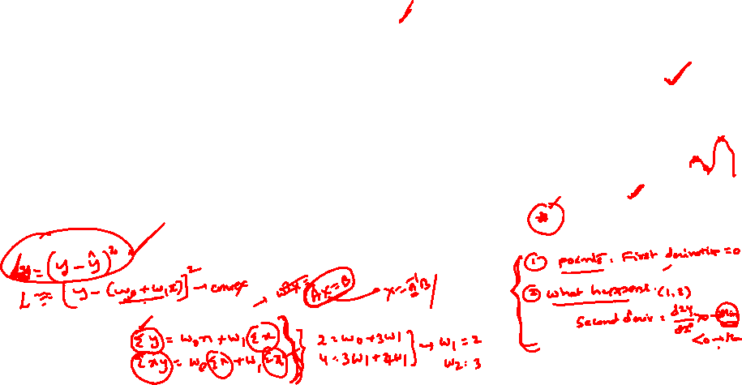
Visualizing the Error Surface
The error surface is convex with a single global minimum.

Slide 26
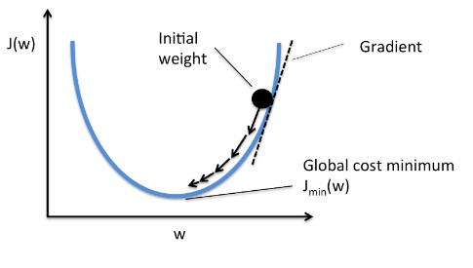
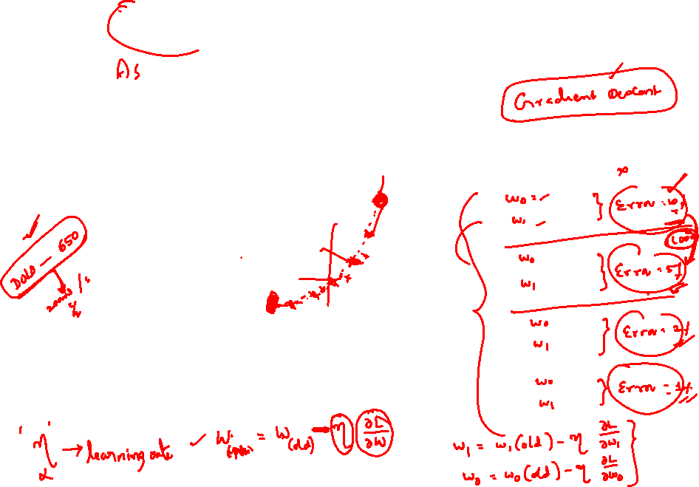
Gradient Descent Algorithm
Idea: Iteratively update weights in the direction of steepest descent
where η > 0 is the learning rate (step size).
Intuition: Move downhill on the error surface to find the minimum.

Slide 27
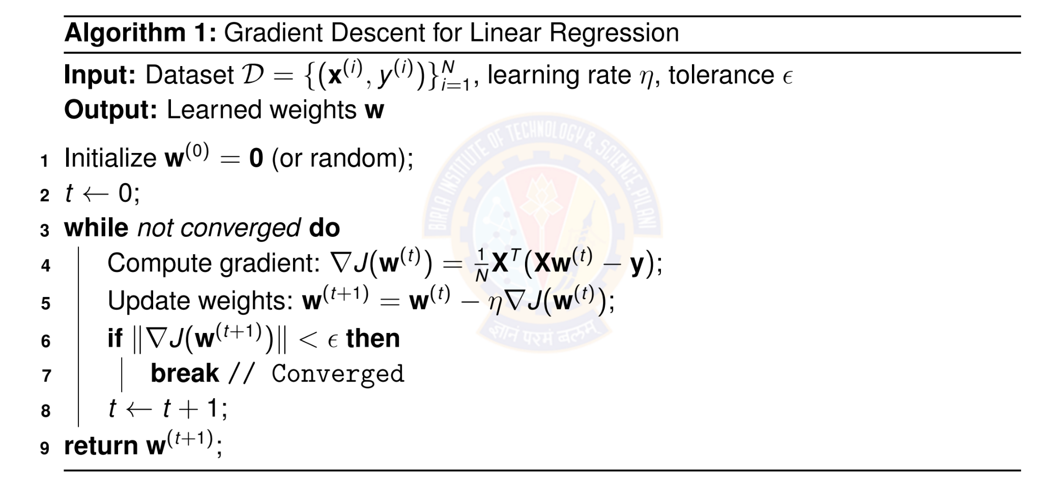
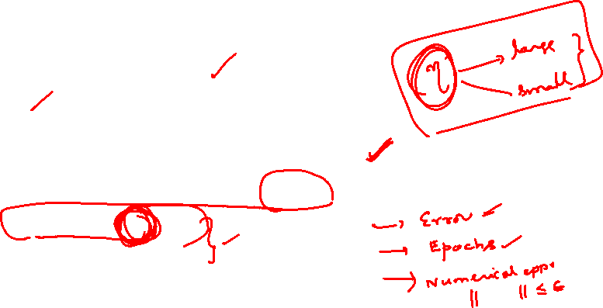
Batch Gradient Descent Algorithm

Slide 28
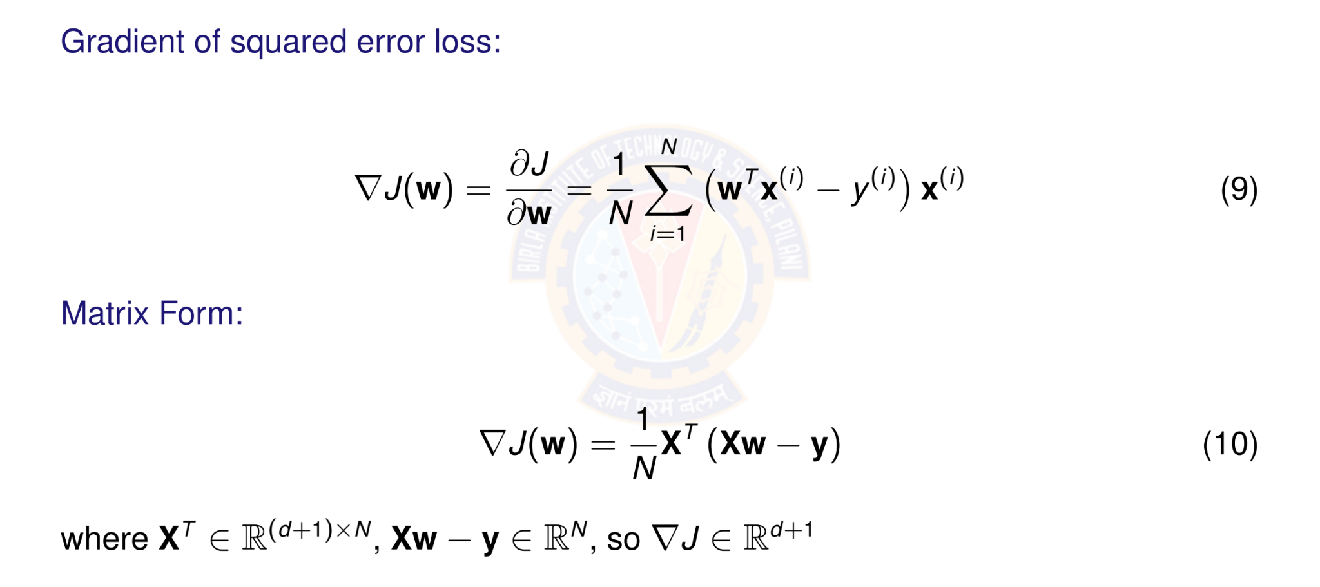
Computing the Gradient

Slide 29
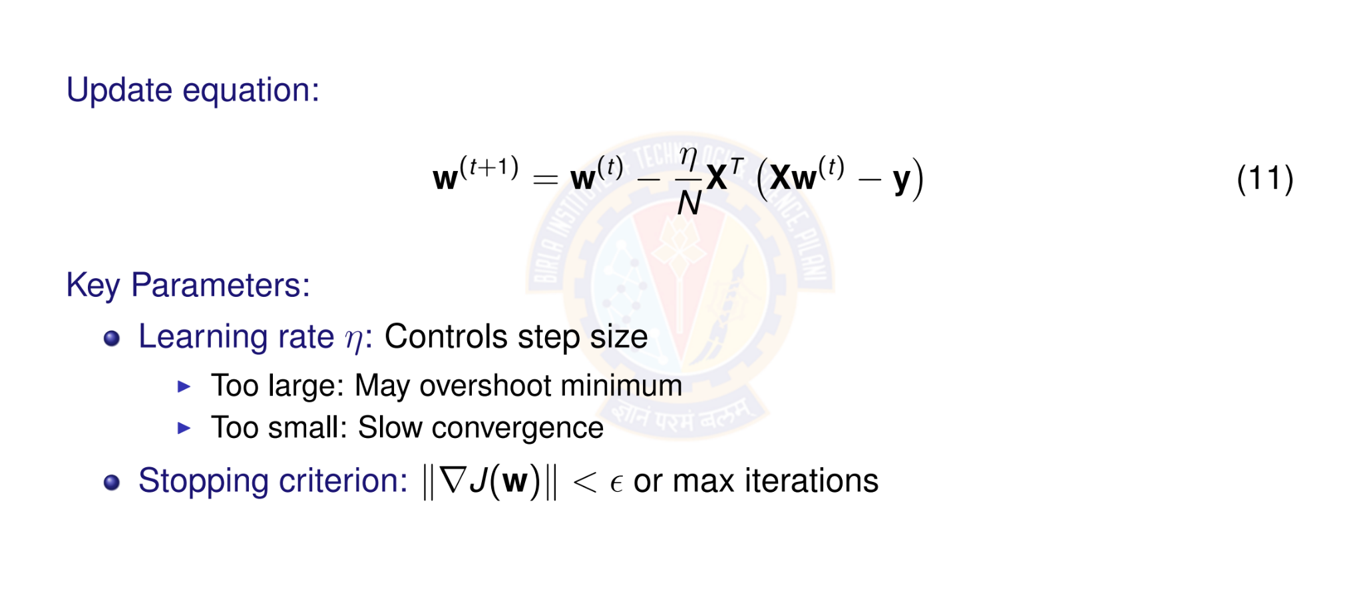
Gradient Descent Update Rule

Slide 30
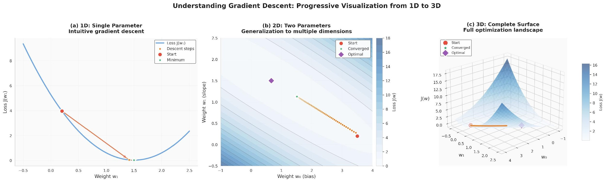
Visualizing Gradient Descent

Slide 31
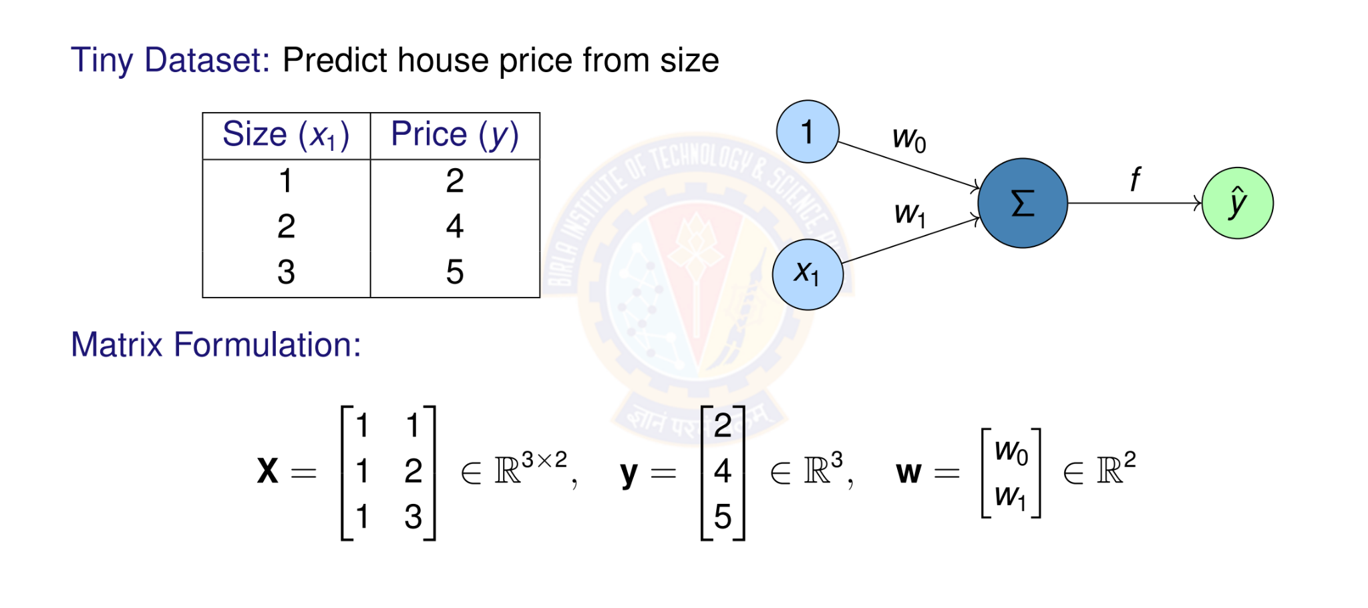
Numerical Example: Setup

Slide 32
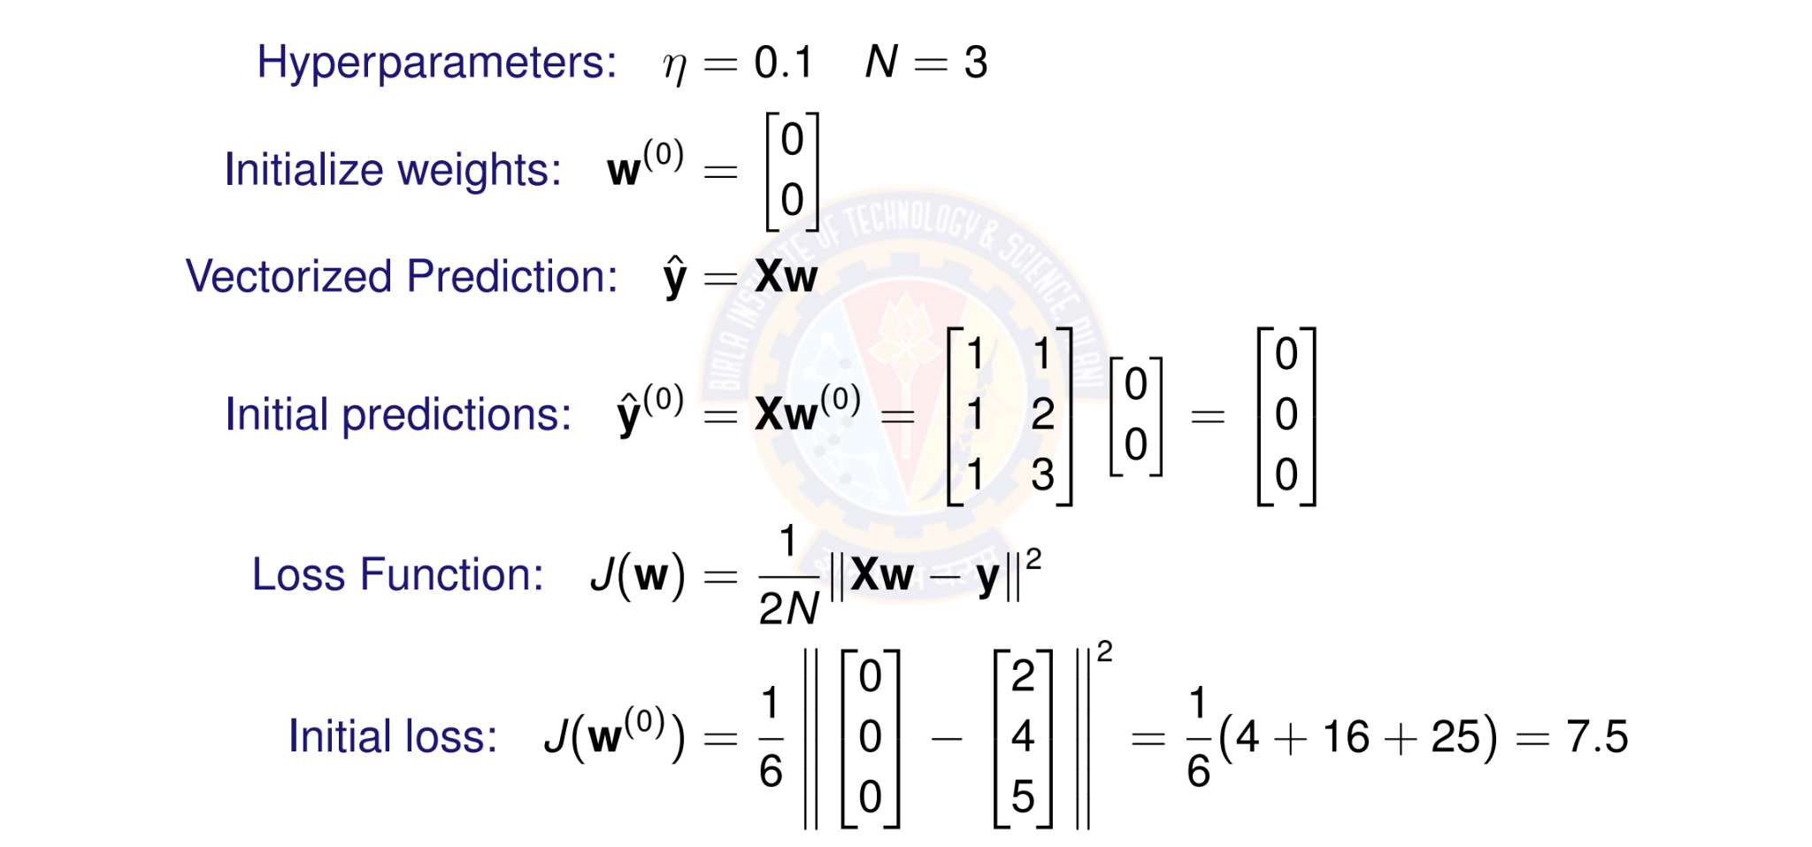
Numerical Example: Initialization

Slide 33
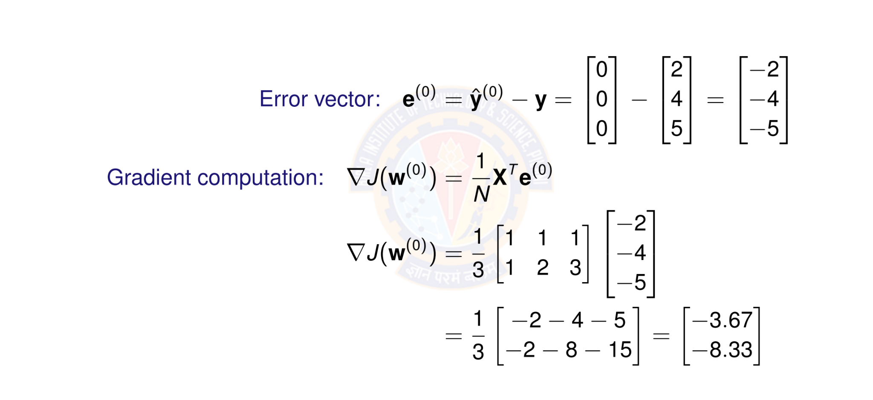
Numerical Example: Computing Gradient

Slide 34
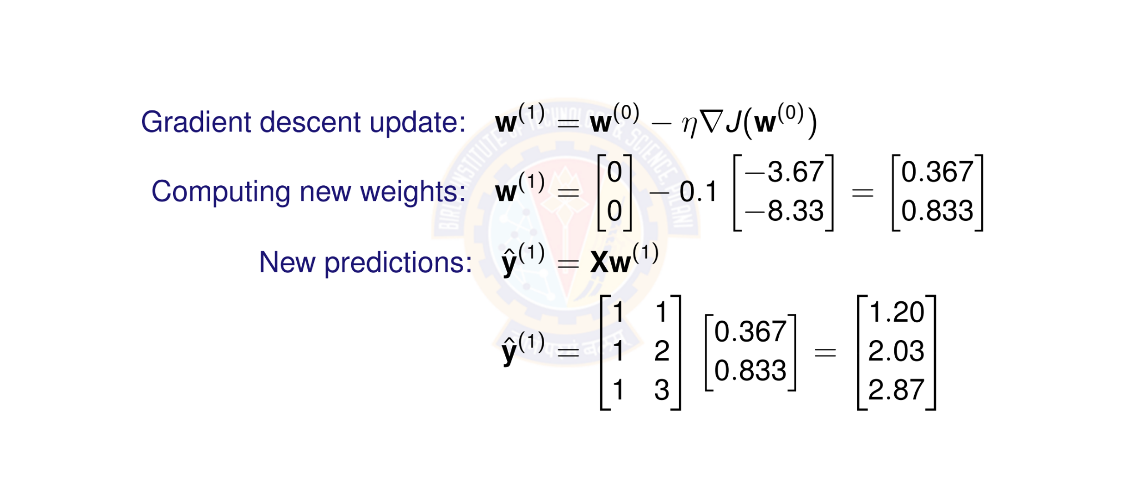
Numerical Example: Weight Update

Slide 35
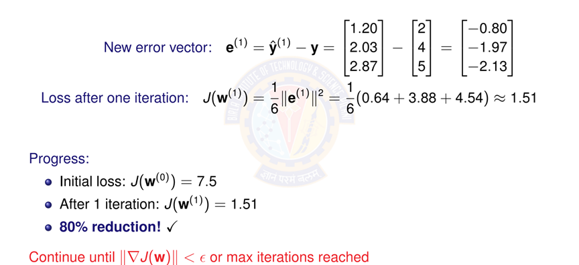
Numerical Example: New Loss

Slide 36
Computational Graph for One Gradient
Parameters Input Data Targets
_{w}(t )
 | —η
X
y
Updated
_{w}(t +1)
×
∇J
_{X}T
y^{ˆ}
—
Loss
1 _{e}
∇J
N
e
·
2
J(w)

Slide 37
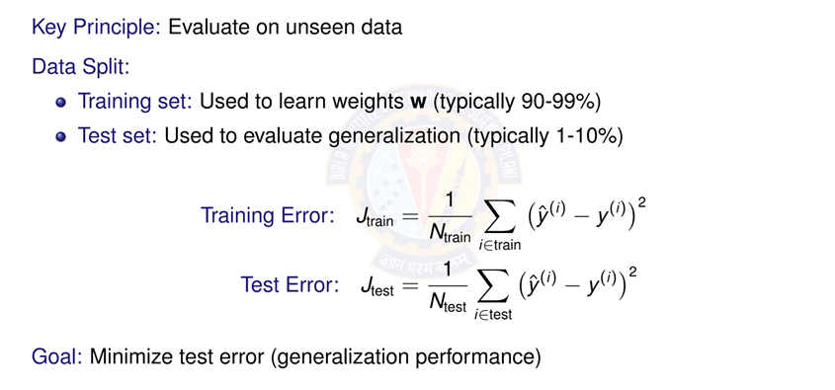
Model Evaluation: Training vs Test Error

Slide 38
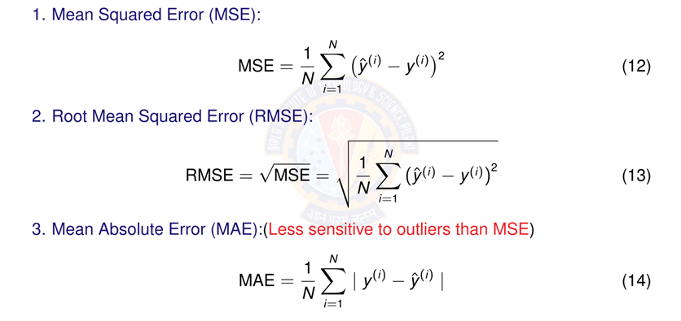
Evaluation Metrics

Slide 39
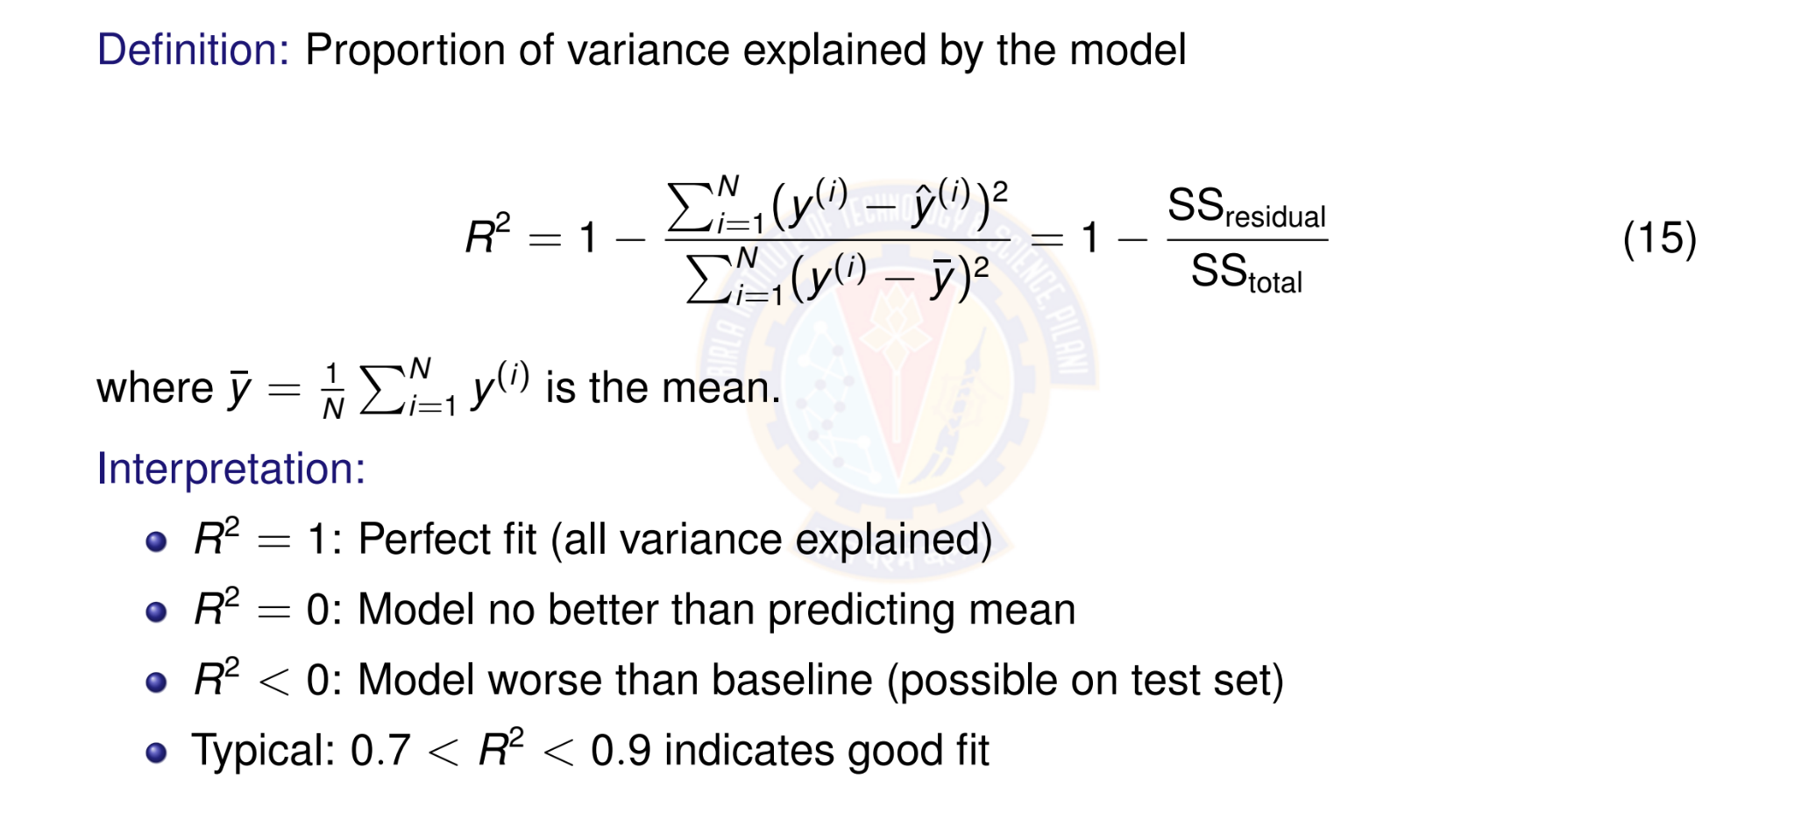
R² Score (Coefficient of Determination)

Slide 40
Perceptron Demo Python Code
https://colab.research.google.com/drive/ 10whoZYodz1H02mbVwsmTudwxaU18ukaI?usp=sharing
Student pl note:
The Python notebook is shared for anyone who has access to the link and the access is restricted to use BITS email id. So please do not access from non-BITS email id and send requests for access. Access for non-BITS email id will NOT be granted.

Slide 41
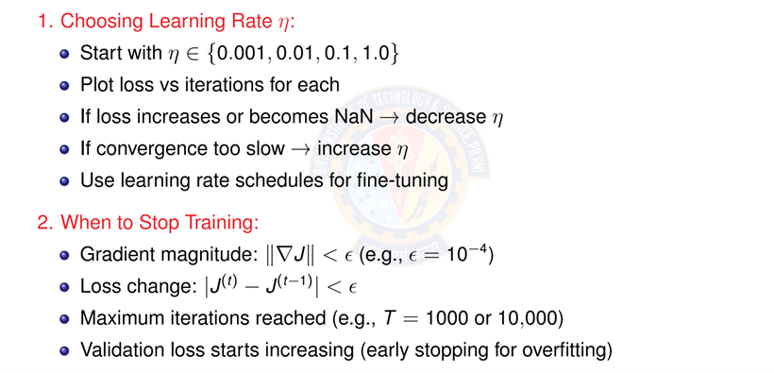
Tips for Implementation

Slide 42
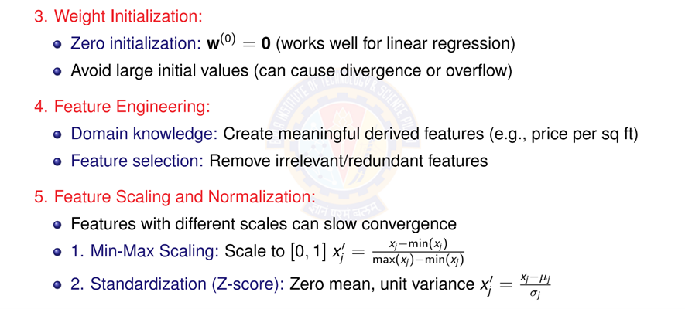
More Practical Tips

Slide 43
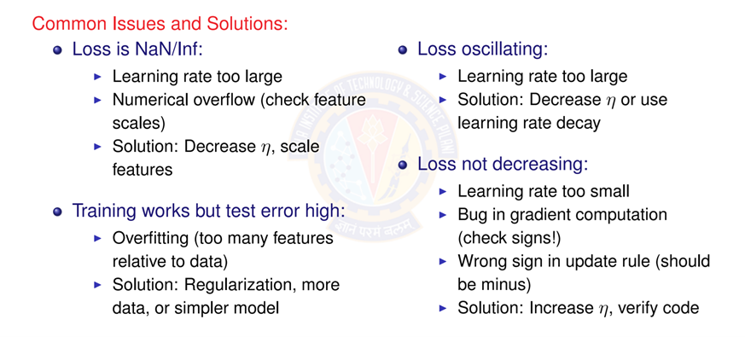
Debugging Checklist

Slide 44


Summary: Putting It All Together
1. Data & Initialization
D = {(x^{(i)}, y ^{(i)})}
_{w}(0) ₌ ₀
2. Model
x₁
^{x2} Σ y^{ˆ}
x_{d}
Linear Activation Function
forward
iterate
Linear Regression Model
compute
4. Learning
—η∇J
_{w}(t ) _{w}(t +1)
3. Objective
minimum
J(w)
MSE Loss Function
gradient
This framework extends to more complex models: neural networks, deep learning!

Slide 45
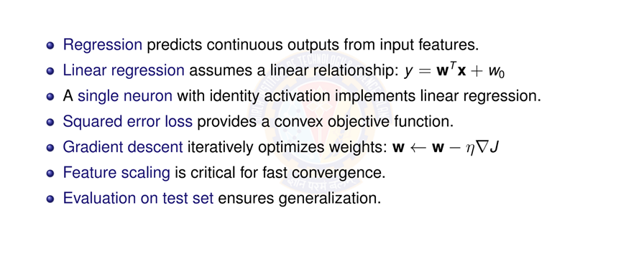
Key Takeaways

Slide 46
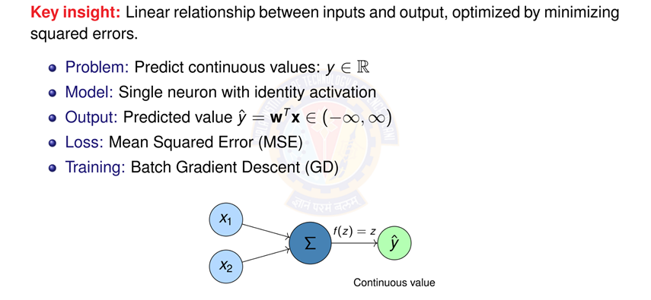
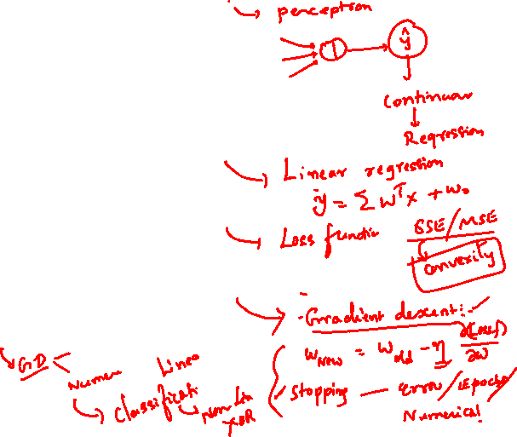
Linear Regression

Slide 47



